Slide 1


FEMORAL HERNIA AND PARNORMAL HERNIAS
Presented by:
Kowshik
No:72

Slide 2
Contents
Femoral hernia.
paranormal hernias and Management
other hernias

Slide 3
Femoral hernia
A femoral hernia is a protrusion of extraperitoneal tissue, peritoneum and sometimes abdominal contents through the femoral canal.
Femoral canal is the medial most compartment of femoral sheath, which extends from femoral ring above to sap heinous opening below.
It is bounded
anteriorly; by inguinal ligament
posteriorly; by iliopectineal ligament of cooper, pubic bone and fascia covering pectineus muscle
medially; by concave lacunar ligament (GIMBERNAT’S Ligament)
laterally; thin septum seperating from femoral vein

Slide 4
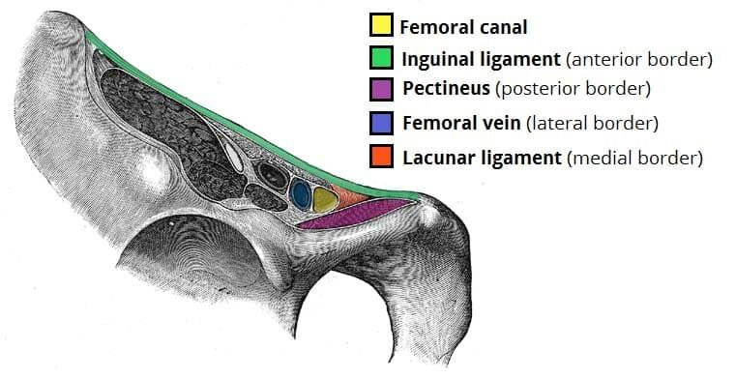

Slide 5
Features
  common in females (2:1 ratio)
  rare before puberty
  more common on right side
  presents as a swelling in the groin below and lateral to pubic tubercle
  swelling, impulse on coughing,reducibility, dragging pain are the usual features
  often associated with inguinal hernia
  40% of femoral hernias present as emergency with obstruction/strangulation

Slide 6
Treatment
  surgical approaches
  Lockwood-low operation:
Here sac is approached below the inguinal ligament through groin crease incision. So that fundus of the sac is dissected by direct vision and repair is done frown below
  Mc’Evedy-high operation:
A incision is made over the femoral canal extending vertically above the inguinal ligament. Sac is dissected from below, neck from above and repair is done from above. It is done in strangulated femoral hernias.

Slide 7
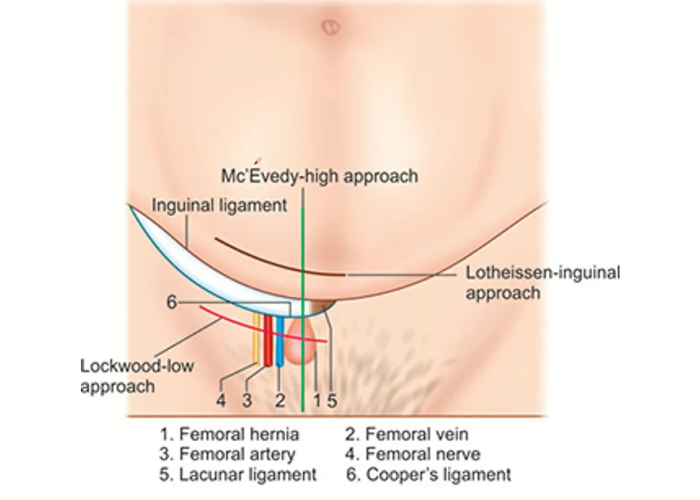

Slide 8
  lotheissen’s operation:
It is through inguinal canal approach. Transversalis fascia is opened and neck of the sac is identified in the femoral ring.sac is dissected from above, neck is lighted and repair is done.
  Lotheissen’s repair:
After herniotomy, conjoined tendon is sutured to the iliopectineal line (ligament) by interrupted sutures. Care should be taken to avoid injury to femoral vein, bladder, pubic branch of obturator artery
  AK Henry’s approach :
Repair of bilateral femoral hernia through lower abdomen incision

Slide 9
Para normal hernias
  Incisional hernia
  Umbilical hernia
  Epigastric hernia
  Spigelian hernia
  Richter’s hernia
  Parastomal hernia

Slide 10
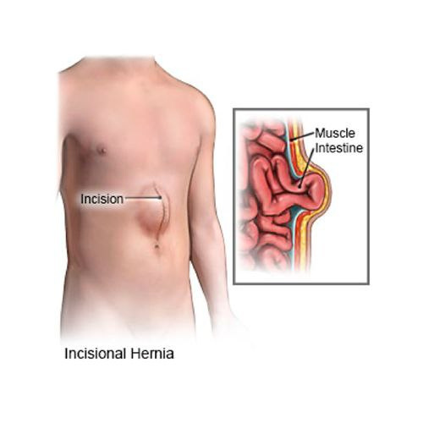
Incisional hernia
  It is herniation through a weak abdominal scar (of previous surgery)
  It is common in old age and obese
  It can be identified as a swelling in the safe region
  Eventually features of irreducibility, obstruction, strangulation is seen
  It is common in lower abdomen
  chronic cough, smoking, obstructive uropathy, constipation can precipitate incisional hernia

Slide 11
Management
  mesh repair (sublay, underlay, overlay)
  Rive’s stoppa’s mesh placement is placing the mesh between posterior recuts sheath and recuts muscle
  Catell’s operation : layer by layer anatomical repair is done using non-absorbable intermittent suturing.sac should be dissected, lighted and excised proir to repair
  keel operation: scar is excised beyond margin ana sac is inverted using continuos/intermittent inverting non absorbable sutures. Done in large defects
  Nuttal’s operation: recti attachments are detached and crossed and fixed to opposite pubic bones to create firm support

Slide 12
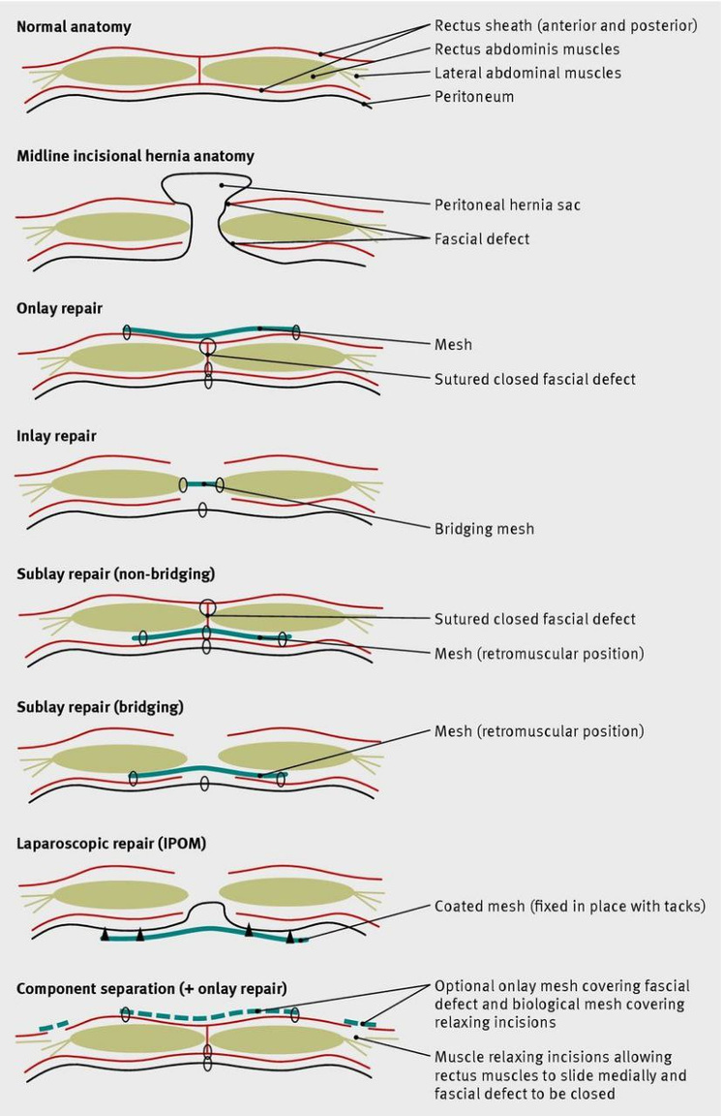
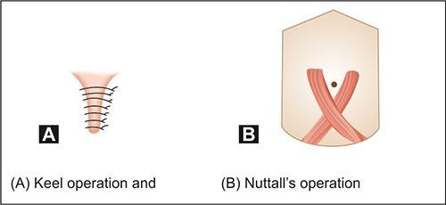

Slide 13
Umbilical hernia
  Intestines protrude through the abdominal muscles at umbilicus
  It is located at the level of L4 and L5 vertebral disc
  umbilical ring is a complex structure. It is related to linea Alba, falciform ligament, obliterated urachus and umbilical fascia (Richet’s fascia)
  The skin is supplied by T10 spinal cord
  It can be congenital
  males are more effected
  It is common in Down’s syndrome, Beckwith-Weidman syndrome, ascites

Slide 14
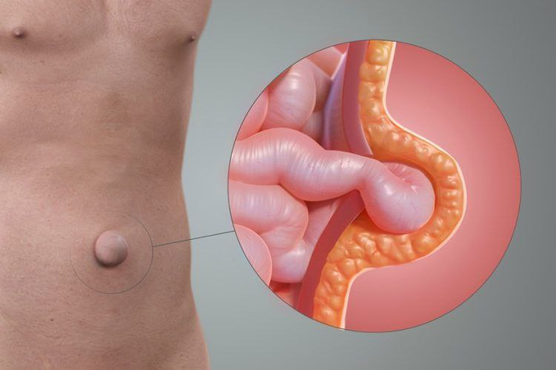

Slide 15
Treatment
  Initially conservative , in 93-95% of cases it disappears spontaneously in few months after birth
  mayo’s operation : Here the horizontally opened recuts sheath is approximated as double breasting
  umbilectomy: excision of umbilical cicatrix which is the removal of thin skin over the large umbilical hernia
  sublay mesh repair: The infra umbilical incision should extend laterally on each side and the sac is excised after excision use mesh in retro recuts position and recuts sheath closed

Slide 16
Epi gastric hernia
  It occurs through a defect in the deccusation on of the fibres of linea Alba, anywhere between diploid process to umbilicus
  It is a sac-less hernia. later sac drags peritoneum and becomes true epi-gastric hernia
  20% of these are multiple - Swiss cheese like
TREATMENT:
  vertical incision given, defect is closed with non-absorbable interrupted sutures
  complete reconstruction of linea Alba is needed

Slide 17
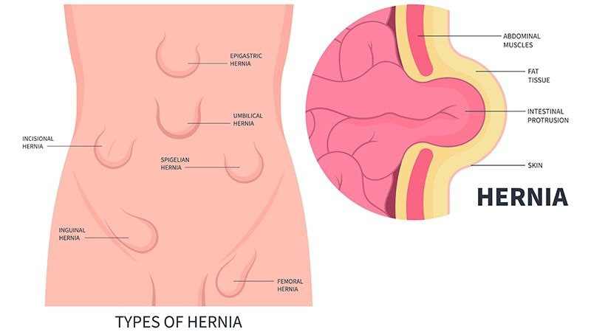
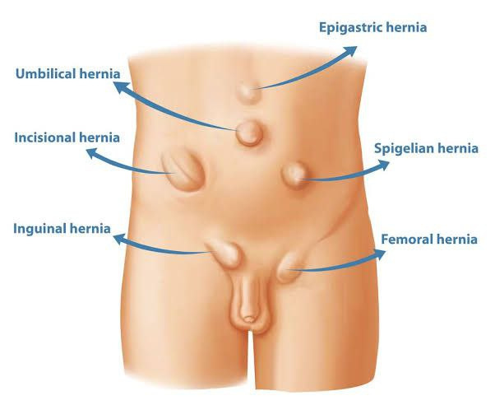

Slide 18
Spigelian hernia
  It is type of intra-parietal hernia o curing at the level of actuate line through spigelian point.
  hernial sac lies either deep to the internal oblique or between external and internal oblique muscles
  It is lateral ventral hernia at any point on spigelian line
  Semi-lunar line of spigel is a line from pubic tubercle to tip of 9th costal cartilage
  It is treated through a lengthy transverse incision herniotomy and later closure of defect layer by later by using intermittent sutures

Slide 19
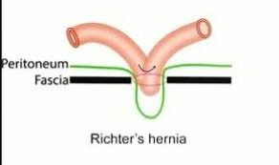
Richter’s hernia
  It is a hernia in which the sac contains only a portion of the circumference of intestine(small bowel)
  It is usually seen in femoral hernia
  There are no features of intestinal obstruction.
  It is treated by resection and anastomosis
  and mortality increases with delay in surgical intervention

Slide 20
Parastomal hernia
  It is the herniation Of intestine on the side of bowel stoma - ileostomy/colostomy/other stomas
  It can be subcutaneous/interstitial/intrastomal/perstomal
  Surgery is indicated in recurrent obstruction, narrow neck, strangulation, interference with stoma
  stoma is dissected, hernia content reduced and defect is repaired

Slide 21
Other hernias
  Littre’s hernia: the content is Meckel’s diverticulum
  Mayld’s hernia: It is a condition where two loops of Bowel remain in the sac and connecting loop remains in abdomen and becomes strangulated. Looks like ‘W’
  Amyand’s hernia: It is a hernia where appendix is the content
  obturator hernia: Hernia occurs through obturator foramen
  sciatic hernia: It is the protrusion of peritoneal sac through the greater or lesser sciatic foramen

Slide 22
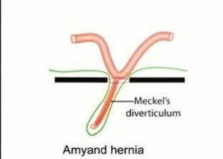
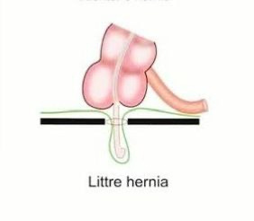
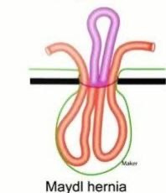

Slide 23
References
  Bailey & love’s short practice of surgery
  SRB’s manual of surgery

Slide 24


